Slide 1
Capstone Project
The Battle of the Neigborhoods

Slide 2
Introduction
The Lawrence Park neighborhood have around Toronto French School and York University,
that it implies a lot of people around is a good idea businesses related to the educational part.
Taking into account the power that this region has,
a businessman desire to place a business aimed at young people but he does not know what type of business to place.
This man hires a specialist to help with this problem.

Slide 3
Problem Description
A businessman desire to place a business aimed at young people, in the Central Toronto Borough in the Lawrence Park neighborhood wants to analyze the businesses around and decide what type of business to place.

Slide 4
Data
Using geo-location for the Central Toronto Borough in the Lawrence Park neighborhood and request from the Page Foursquare we will find the businesses around Lawrence Park neighborhood. Look the table and map below.
With the api of Foursquare take the radius 1000, that mean find veneaus around of 1000 meter, we will analyze, sort and classify working with k-means clustering technique of Machine Learning. After reviewing the results we will take a business decision.

Slide 5
METHODOLOGY
Using the list of neighborhoods, we connect to the Foursquare API to gather information about venues inside near of Central Toronto borough. We take the radius to be 1000 meter. It means that we have asked Foursquare to find venues that are at most 1000 meter far from Central Toronto borough.
Processing the Data and Creating a Data Frame for All the Venues inside the Central Toronto borough. This actions are working with language Python.
When the data is completely ordered, we will perform processing on that raw data to find our desirable features for each venue. Our main feature is the category of that venue. After this stage, the column "Venue's Category" will be One-hot encoded and different venues will have different feature-columns. After On-hot encoding we will integrate all venues columns to one column and joint columns to "Total Joints" column. After applying k-Means Clustering of Machine Learning Techniques.

Slide 6
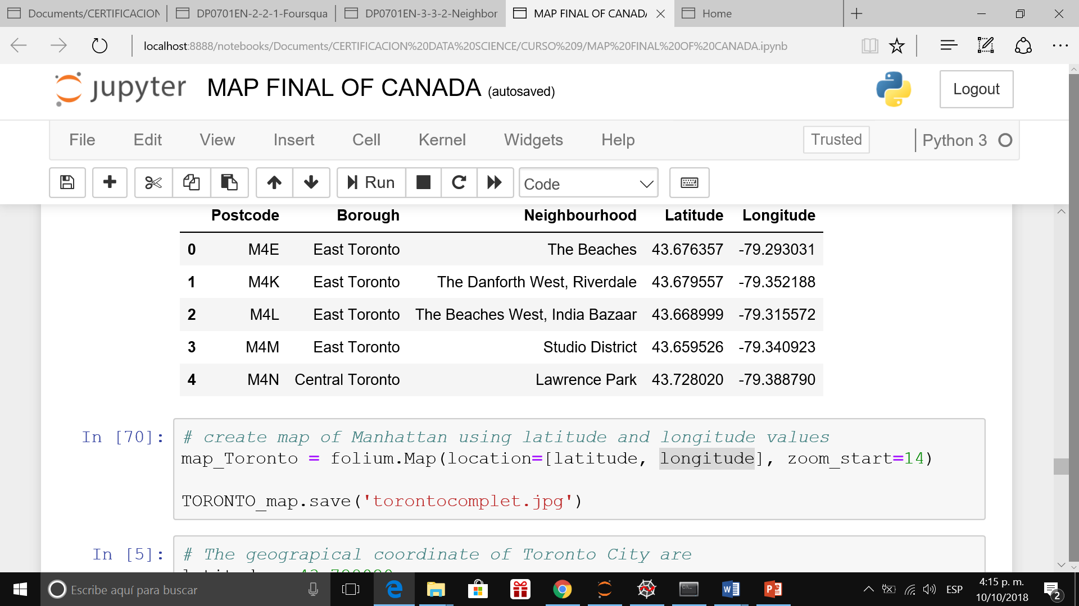
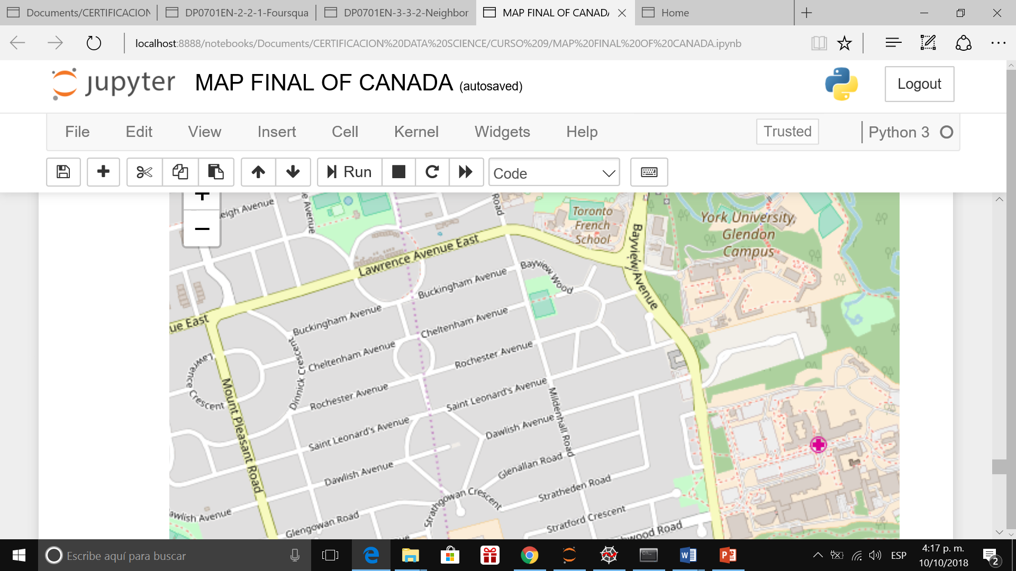
TABLE OF DATA AND MAP

Slide 7
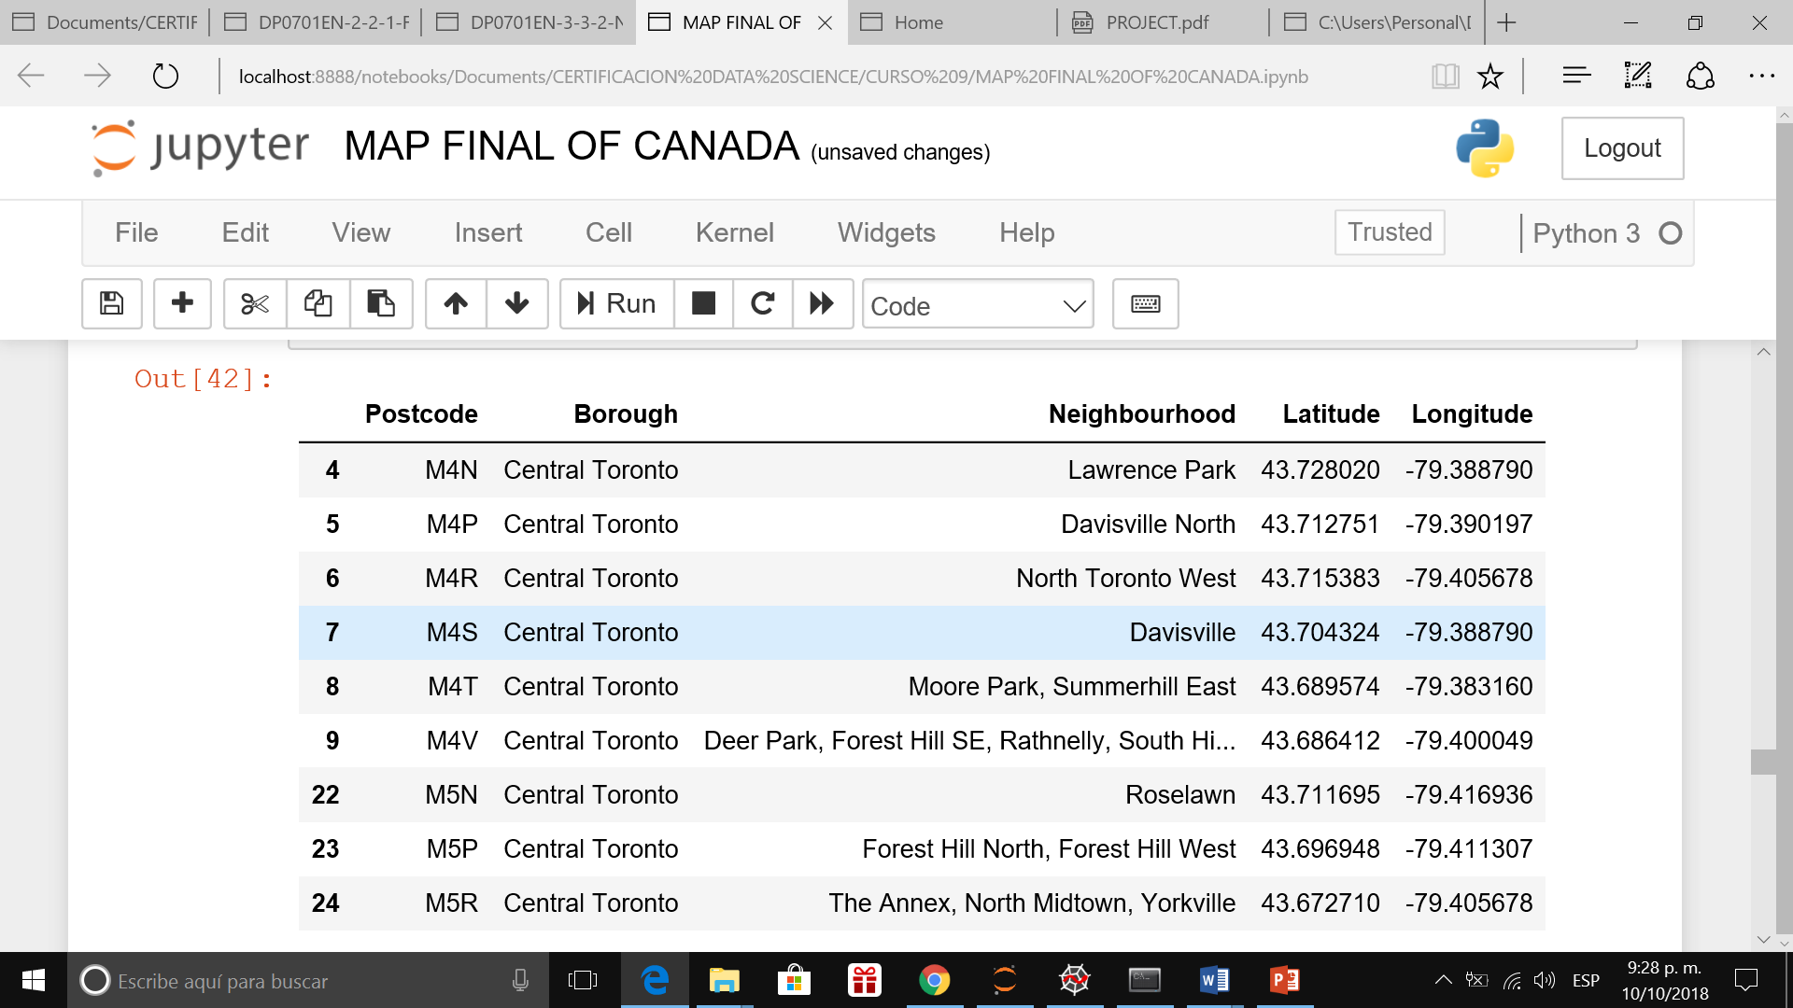
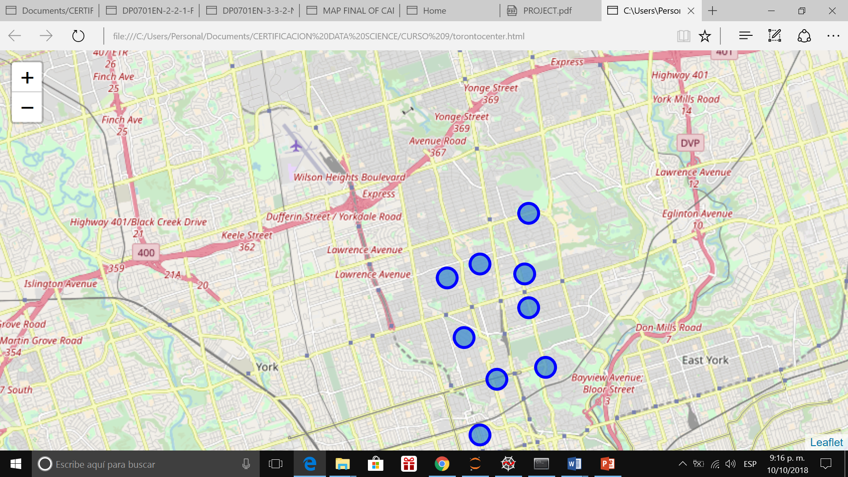
DATA OF CENTRAL TORONTO BOROUGH AND MAP

Slide 8
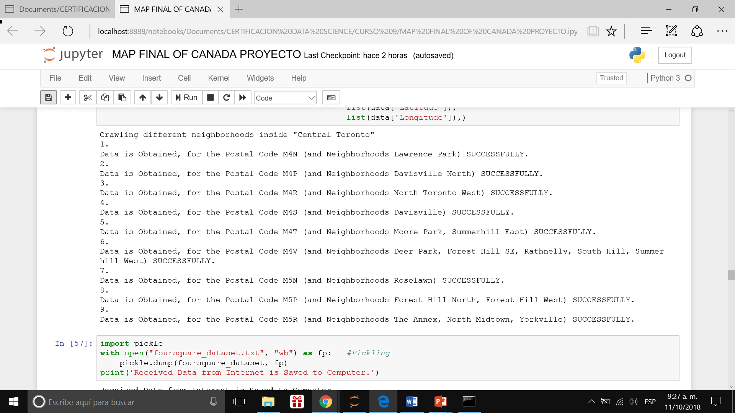
Crawling different neighborhoods inside “Central Toronto BOROUGH”

Slide 9
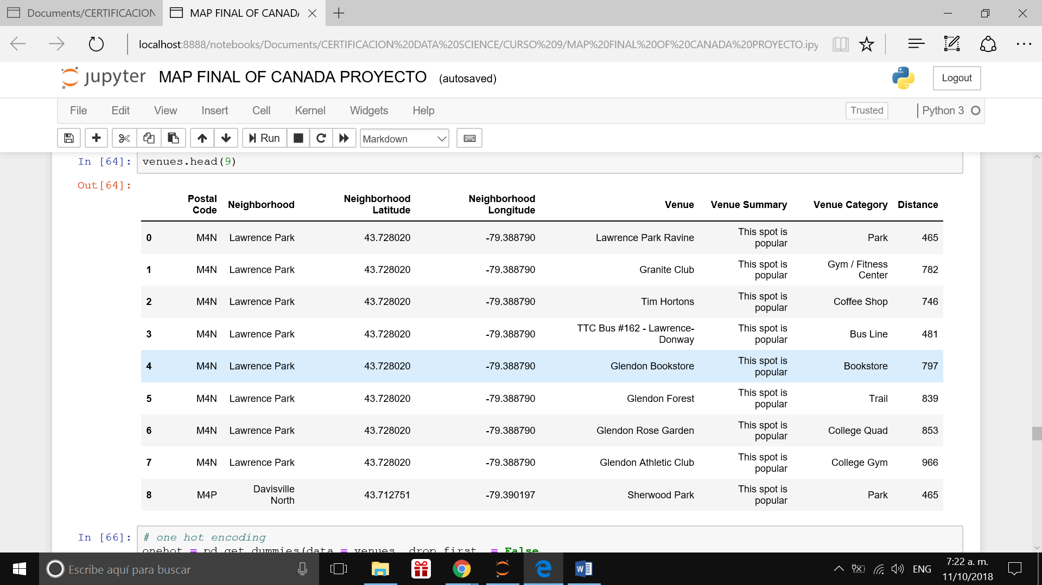
VENUE IN CENTRAL TORONTO BOROUGH USING FOURSQUARE

Slide 10
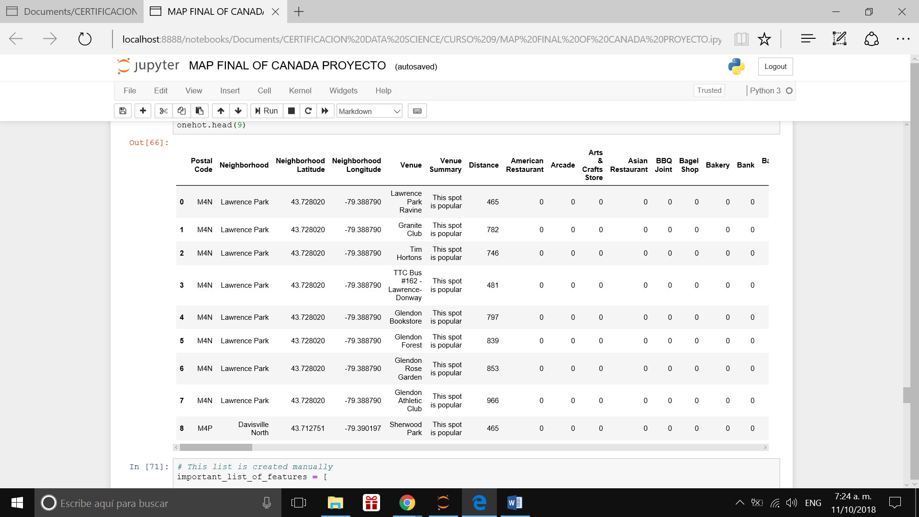
OTHERS VENUE IN CENTRAL TORONTO BOROUGH USING FOURSQUARE

Slide 11
RESULT
There are two Neighborhood in Central Toronto Borough, Lawrence Park and Davis Ville North.
There are 9 venues in Central Toronto Borough.
There are not American Restaurant, Arcade, Art and Crafts Store, Asian Restaurant, Shop, Bakery, Bank.

Slide 12
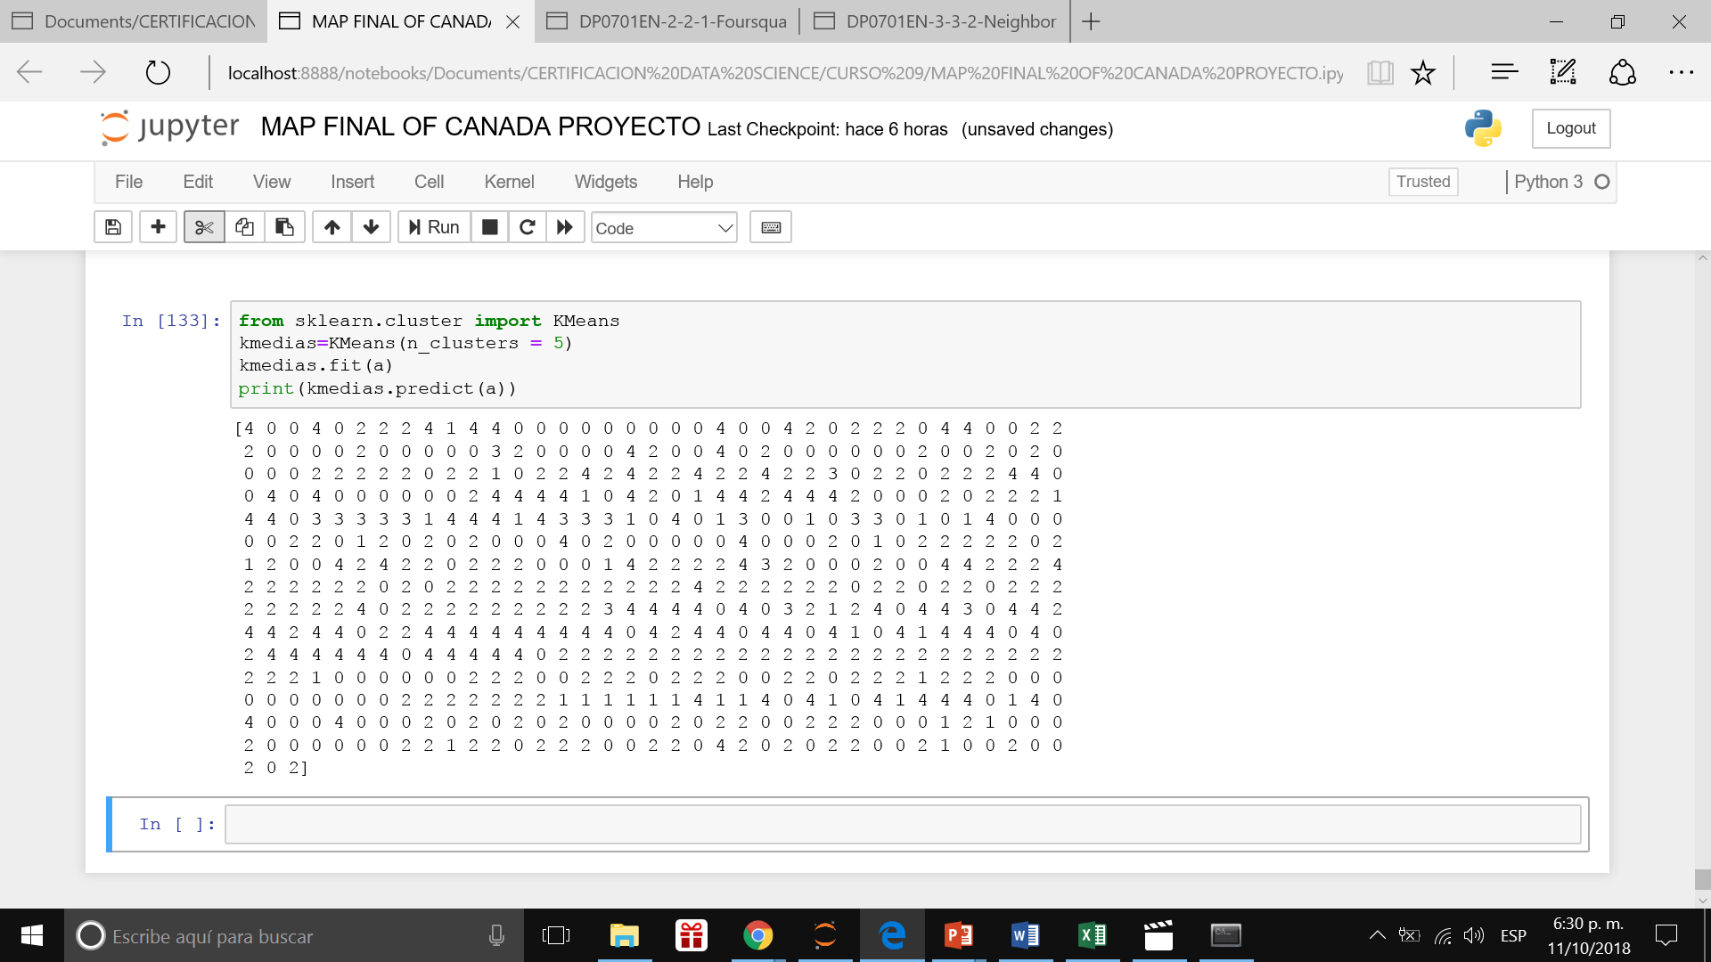
RESULT KMEAN 5 CLOUSTERS ABOUT THE DISTANCE FROM BUSINESS

Slide 13
RESULT

Slide 14
CONCLUSION / Business Decision
TAKING INTO ACCOUNT THAT THERE IS A UNIVERSITY, ONE SCHOOL, TWO PARKS AND A LINE OF BUS TO ACCESS AND THAT THERE IS NOT ARCADE, WE PROPOSED A BUSINESS RELATED TO ARCADE FALTARY TO MAKE A FIELD WORKING WITH THE PEOPLE ABOUT THE FEASIBILITY OF THIS BUSINESS.

